Slide 1
PROJECT TITLE - FAKE ADS
PROBLEM STATEMENT
To indicate whether or not a particular internet user clicked on an advertisement based on their features provided.
PRESENTED BY MONEESH B

Slide 2
OVERVIEW OF THE PRESENTATION
INFORMATION ABOUT THE DATASET
EXPLORATORY DATA ANALYSIS
SELECTION, TRAINING, FITTING OF THE MODEL (MODEL SELECTION)
EVALUATION OF THE MODEL

Slide 3
SOURCE & STRUCTURE OF THE DATASET
The dataset was taken from Kaggle.
The record contains 10 columns and 1000 rows.
Each row represents a particular person’s features.
Out of the 10, 4 columns are of type string and the rest are of numerical values.

Slide 4
VISUALISATION OF THE DATASET
This data set contains the following features:
'Daily Time Spent on Site': User’s time on site in minutes.
‘Age' : User’s age in years.
'Area Income’ : Avg. Income of geographical area of the user.
'Daily Internet Usage’ : Avg. Minutes a day the user is on the internet.
'Ad Topic Line’ : Headline of the advertisement.
‘City' : City of the user.
‘Male' : Whether or not the user was male.
‘Country' : Country of the user.
‘Timestamp' : Time at which the user clicked on the Ad or closed the window.
'Clicked on Ad’ : 0 or 1 (Indicating if the Ad was clicked or not).

Slide 5
GETTING AN OVERVIEW OF THE DATASET
The required libraries are imported. These include NumPy, Pandas, Seaborn and Matplotlib.
Next, the dataset is imported as a data frame by suitable commands.
Commands such as head( ), info( ) and describe( ) are performed to get a clear picture of the dataset.
Checking the presence of NULL values is performed and this dataset doesn’t contain any.

Slide 6
EXPLORATORY DATA ANALYSIS
Now, the Seaborn Library is used to explore the data.
Several Data Visualisation Techniques are performed on the data.
Meaningful informations are derived from these techniques.
These include Histograms, Pair-Plots, Joint-Plots and KDE.

Slide 7
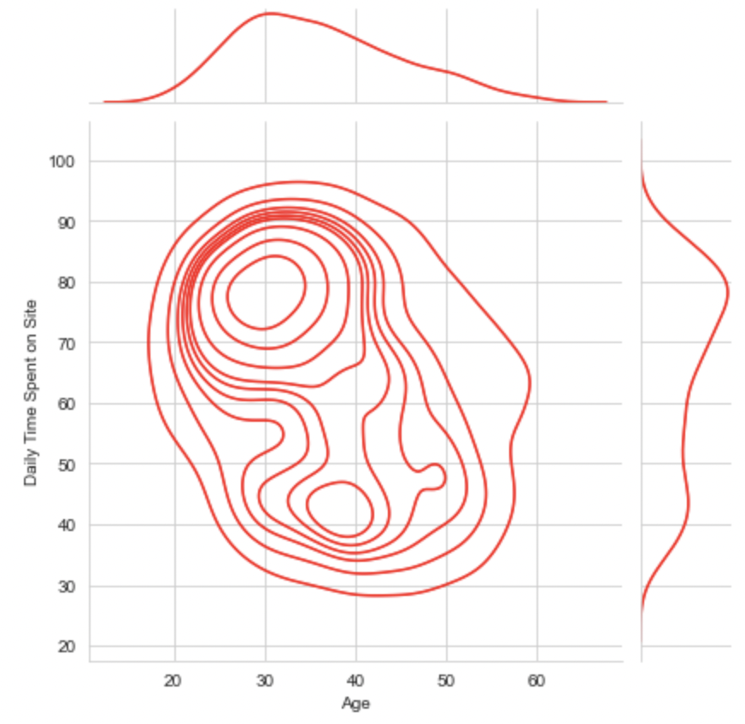
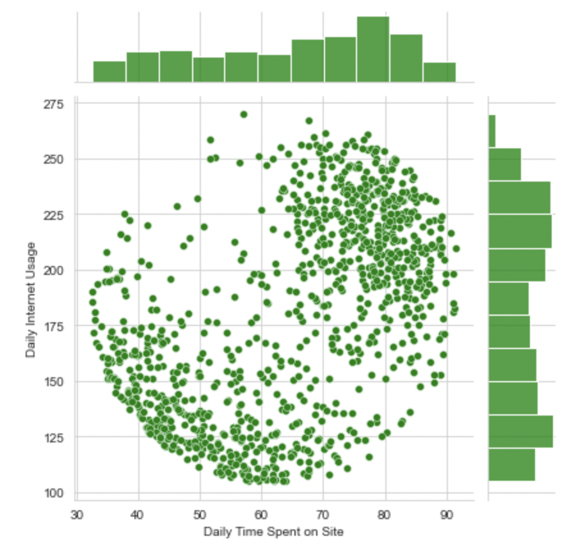
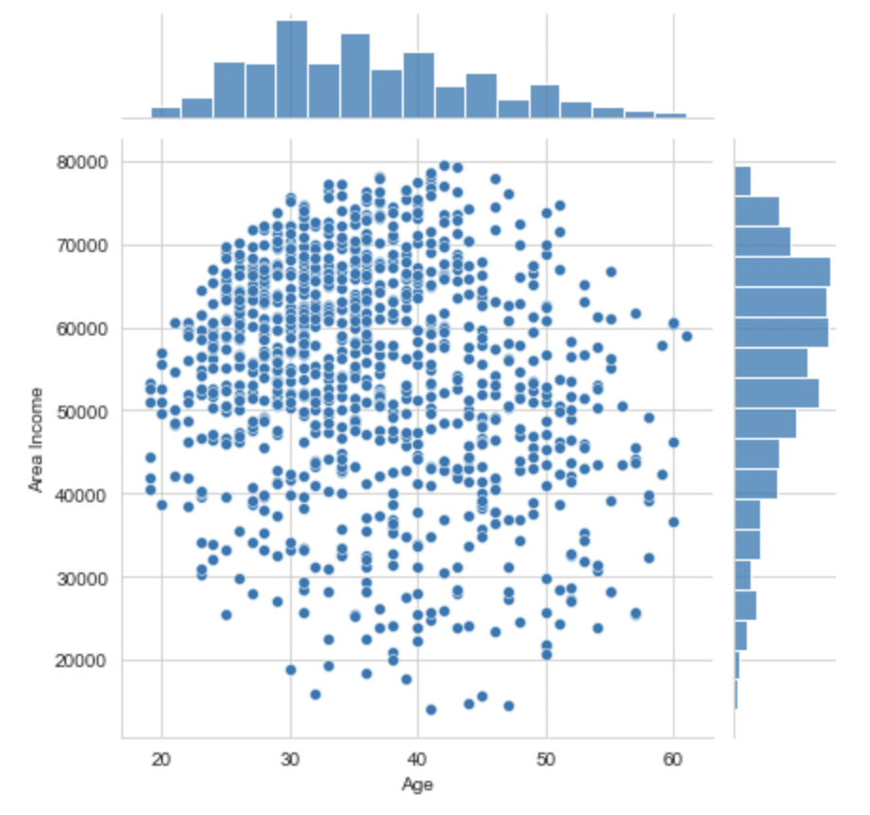
RELATION BETWEEN VARIABLES - JOINT PLOTS

Slide 8
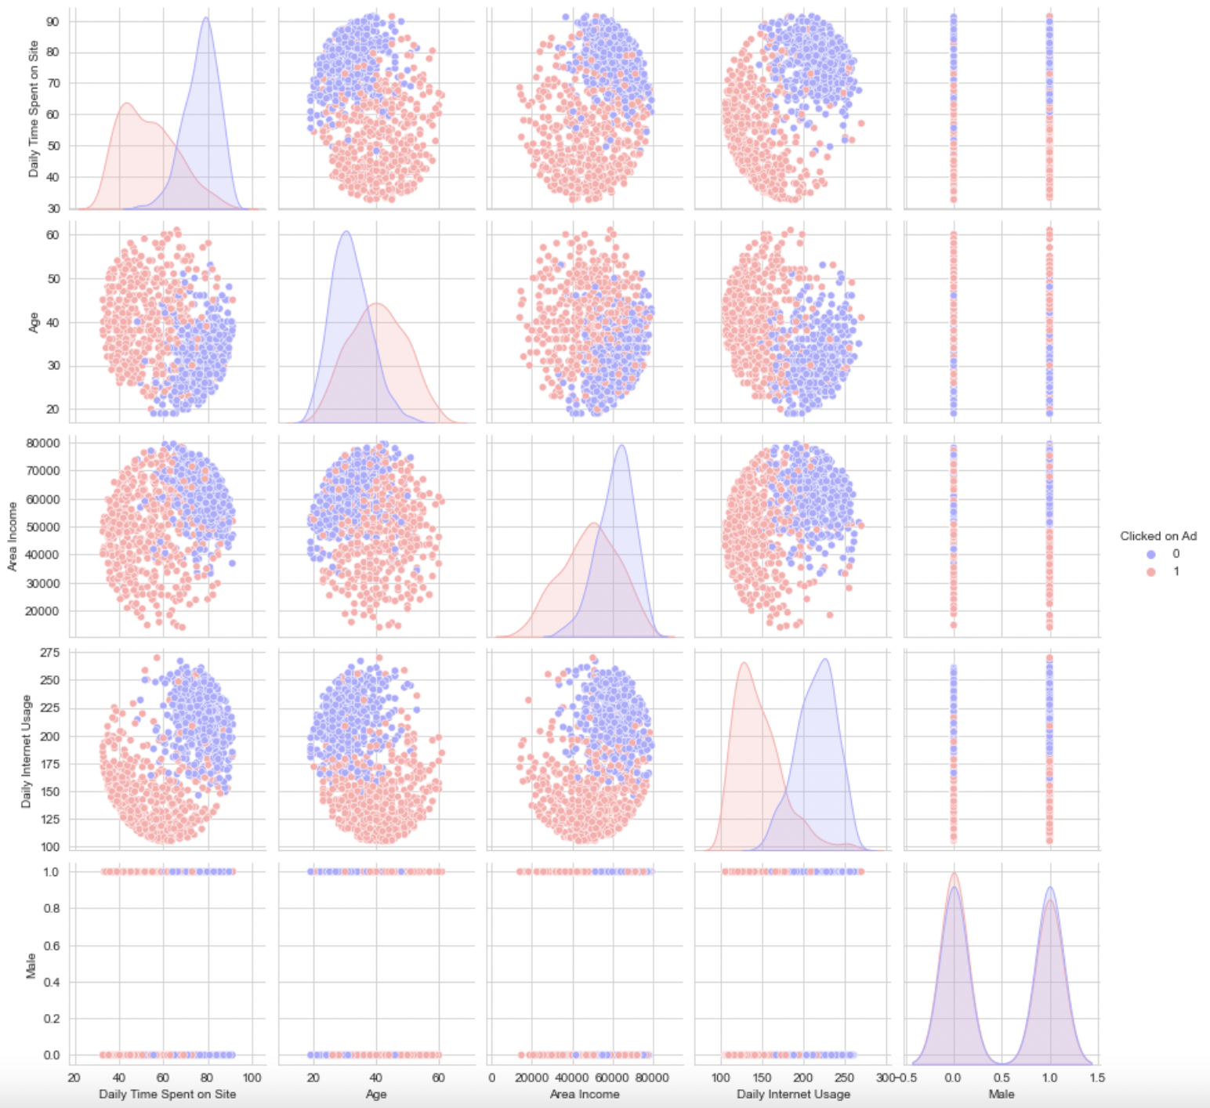
RELATION BETWEEN VARIABLES - PAIR PLOT

Slide 9
SELECTION, FITTING & TRAINING OF MODEL
By looking at the plots and the behaviour of the variables we come to a conclusion that Logistic Regression is the best suited algorithm.
The training and testing of the data is done by importing the Scikit Learn Library.
Here, we exclude the string attributes as they don’t have much of an effect.
The other variables excluding the target variable are assigned accordingly (to X) whereas the target variable is assigned to Y.
Logistic Regression model is imported and trained. Now the model is ready for prediction.

Slide 10
PREDICTION & PERFORMANCE OF THE MODEL
The prediction is done using the testing data and the prediction is then compared.
The comparison is done by importing the Classification Report to evaluate the model’s performance. Confusion Matrix can also be imported for calculating the accuracy.
LINK TO SOURCE CODE AND DATASET
CODE - https://bit.ly/3hGTEnT
DATASET - https://bit.ly/3CjhMoC

